Slide 1
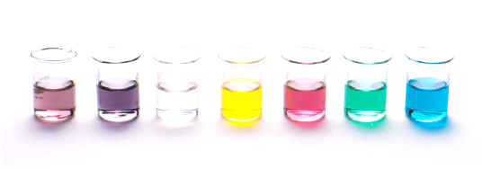
Alcohols
Lesson Outcome:
Naming Alcohols
Understand the properties of alcohols and be able to explain them using your knowledge of intermolecular forces
Resources:
Essential Chemistry, ch 11.2 and 11.3, pages 118-119
Problem set 16 Q 1 – 5

Slide 2
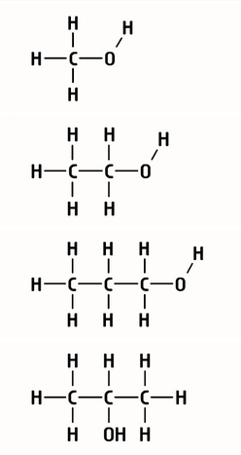
Naming alcohols
What were the three alcohols we made with the molymods in lab 29?
Methanol
Ethanol
Propanol
CH₃OH
CH₃CH₂OH
CH₃CH₂CH₂OH
CH₃CH(OH)CH₃
CH₃OH
C₂H₅OH
C₃H₇OH
propan-1-ol
propan-2-ol

Slide 3
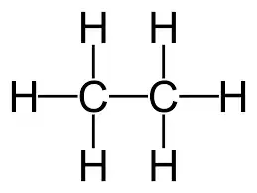
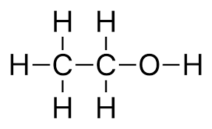
Naming alcohols
Alcohols contain the functional group –OH (hydroxyl)
Naming we drop the final e from the base alkane name and add the suffix –ol
we use a number to indicate the position of the –OH group
ethane
ethanol
Replace one H with an –OH group
Replace the final e with -ol

Slide 4
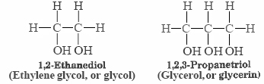
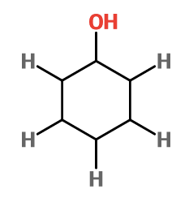
Naming alcohols
If more than one hydroxyl group (-OH) then use diol, triol and so on
Aromatic alcohol (derivative of benzene) is called Phenol

Slide 5
Naming alcohols
The position of the hydroxyl group (-OH) effect the properties and reactivity of the compound
propan-1-ol
propan-2-ol
Primary (1°)
Secondary (2°)

Slide 6
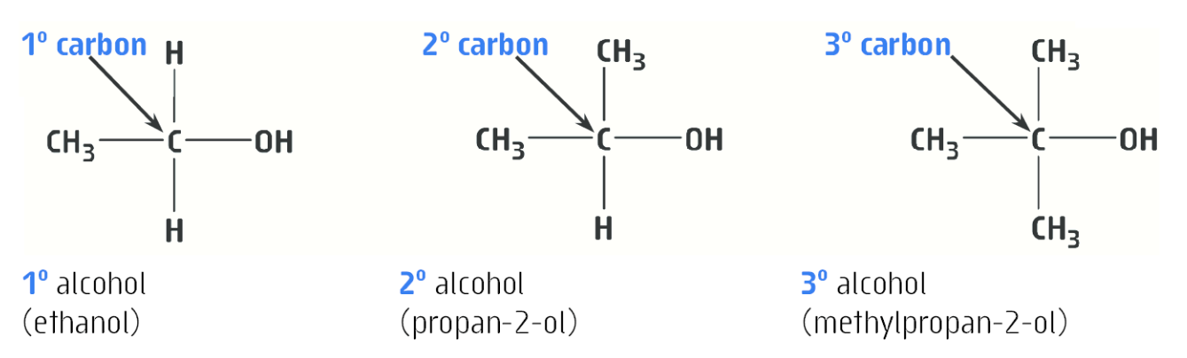
Naming alcohols

Slide 7
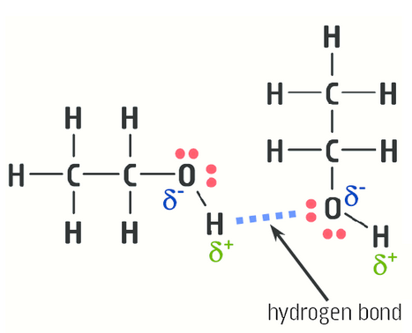
Properties of alcohols
Intermolecular forces (IMF) present effect the physical properties of alcohols
Small alcohol molecules – dominate IMF is hydrogen bonding
As molecules become larger – dispersion forces increase

Slide 8
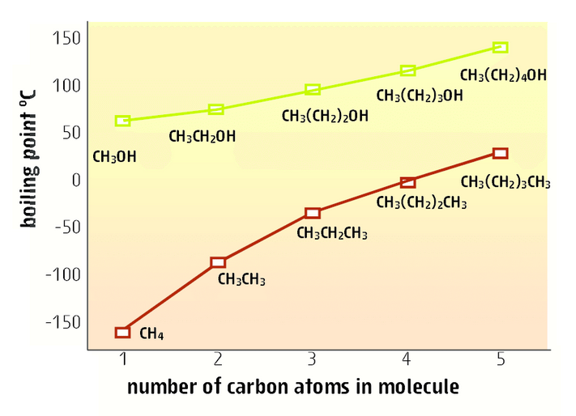
Properties of alcohols
Compare CH₃OH with CH₄, explain the difference in their boiling points.
Why does the boiling point of alcohols increase with the number of carbons?

Slide 9
Properties of alcohols
The presence of hydrogen bonding in methanol accounts for it having a higher boiling point than methane which only contains weaker dispersion forces
As the molecules increase so do the dispersion forces present, so the boiling point increases

Slide 10
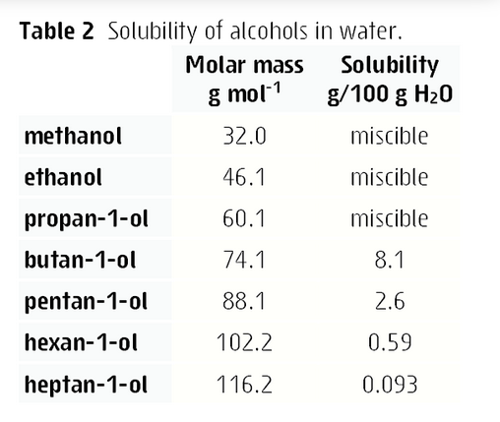
Properties of alcohols
Solubility
Ability of the molecules in a mixture to attract one another as strongly as the molecules of the pure substances do
Alcohols with low molecular weight – dissolves compounds that have hydrogen bonding or dipole-dipole forces e.g. methanol and water
As molecular weight increases – dispersion forces increase, these larger alcohols dissolve non-polar substances that also have dispersion forces.

Slide 11
Properties of alcohols
Using table 2 explain the trend in the solubility of alcohols in water (Table 2)
Alcohols with low molecular weights are miscible with water (soluble in all proportions). Dominate IMF in low molecular weight alcohols is hydrogen bonding, water molecules are also attracted by hydrogen bonding, therefore they are attracted to each other and dissolve.
As MW increases dispersion forces become significant, there are no dispersion forces in water so the molecules are not attracted to each and therefore have lower solubility

Slide 12
On going work
Set 16 Q1-5
Set 15 Q 1,2, 6-11, 12-16
Finish Experiment 29 – you should have a completed table with all examples drawn (even the ones you didn’t have time to build); add the general formulae; and add uses for the different groups of compounds (e.g uses of alcohols, uses of aldehydes etc)

